Slide 1
The Career Tutor
Hiring & Retaining Top Talent
Aaron Golumbfskie
Education Director

Slide 2
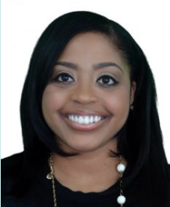
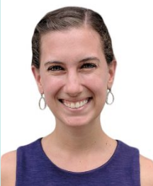
What are we as a company?
What we are is who we are.

Slide 3
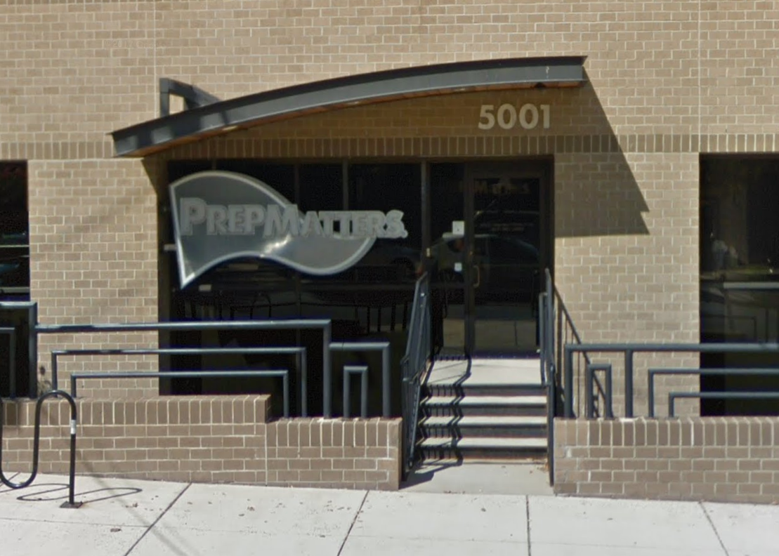
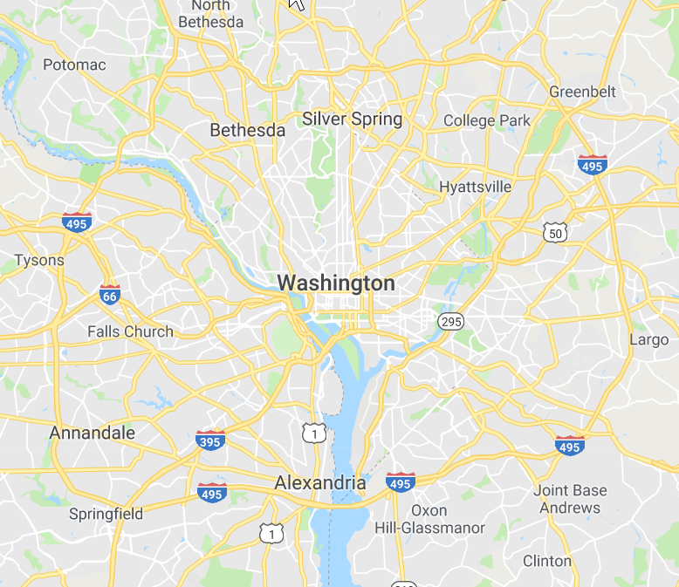
Company Overview
43 Tutors
Exclusively one-on-one
tutoring, test prep &
college planning
2 Counselors / 8 Essay Specialists
2200 Unique Students per Year
Established
in 1998
Three DC Metro
area locations
$200-$400 hourly rate for services
$$-$$$$

Slide 4
Tutoring Staff
10+yrs experience
21% of tutoring staff
35% of tutoring hours
5+yrs experience
42% of tutoring staff
62% of tutoring hours
Time is the longest distance between two places. — Tennessee Williams

Slide 5
Culture
Our core values apply to our clients and our team
Listen to learn
Trust is everything
Sense of control
Change is possible

Slide 6
Our Fearless Leader
SHAMELESS PROMOTION
*
Ned Johnson
Founder & Tutor-Geek
*Includes Chapter 12: “The SAT
the ACT and other 4-letter words”

Slide 7
Hiring | What we look for
Charm is the quality in others that makes us more satisfied with ourselves.
— Henri-Frederic Amiel
Indeed, Craig’s List
Staff referral (bonu$)
Charm & presentation
Client referrals
Personal responsibility
Phone interview
Listening skills
Longevity
Staff teachback
Academics
Testing
Diagnostic testing

Slide 8
Hiring | Staffing for seasonality
+ busier & happier tutors
+ scarcity can create demand
total
capacity
+ little to no “competition” for students
full
schedules
- waiting lists & delayed starts
- crazy September & October
- lose “leverage” with tutors
Sept-Nov
2017
 | 1-9 hrs/wk | 10-19 hrs/wk | 20-29 hrs/wk | 30+hrs/wk
Tutors | 20 | 12 | 7 | 4
The worst form of inequality is to try to make unequal things equal. — Aristotle

Slide 9
Tutor Training
Practice precedes perfection. —Oscar Wilde
Operations
JUN
Weekly 3 hr meetings
Placement process
Student records
Advancement
Staff news & meetings
Lots of HW: average of 120
hrs of training time
Psychology
Time is compensated at
training rate of $15/hr
Positive psychology
Working memory
Stress & Anxiety
Stereotype threat
Pedagogy
AUG
Not everyone completes
the course
P/SAT, ACT & SSAT content
Workbooks & practice tests
Lesson planning
Roleplay & teachbacks
+ shadowing senior tutors
+ session evaluations
+ weekly new tutor roundtable

Slide 10
Compensation & Advancement
Hourly wages & summer bonus
Starting
Cumulative tutoring hours
$35-$60
250
500
1000
2000
3500
5000
n+1500
Performance/compensation review milestones
Raise & bonus = f (hours worked, direct referrals, “stickiness”, ops team survey)
Additional compensation
Rate increases
Flexible spending account
Professional
Senior
Select
$200/175
$250
$325
Paid sick leave
401K employer matching 5%
Tutor compensation adjusted on percentage basis
Access to FSA and health, dental &
vision insurance for part-time staff
Increases depend on company-wide demand and
tutor specific direct referrals

Slide 11
Infrastructure
Placements
team
Client service
concierges
Accounts
manager
You can
always tell
when the
groove
is working.
—Prince
Private
offices
Tutors focus on
being rock stars.
Senior
tutors
Quality
Assurance
manager
Educational
Planning
department
Proprietary
materials

Slide 12
Hybrid Employees
Curriculum
Communications
Template
Maintain/update workbooks
Social media director
$XX,XXX salary based upon:
Rractice test creation &
Scantron scoring
E-marketing
600 tutoring hours
Internal & external comms lead
1400 hours in support role
Bonus based upon:
Technology
Quality Assurance
Additional tutoring hours
Role-based metrics
Webmaster
Make scheduled QA client calls
Full-time position & benefits
SEO & analytics
First line for client complaints
Digital design & branding
Annual client satisfaction survey

Slide 13
Old Tutors, New Companies
Monument City Tutoring Co.
Eagle Eye Tutoring
PrepU
Baltimore, MD
Washington, DC
Washington, DC
ScoreBuilder Test Prep
The Prep Advantage
Stumptown Test Prep
San Diego, CA
Atlanta, GA
Portland, OR
Don’t cry because it’s over; smile because it happened. —Dr. Suess

Slide 14
Thanks for your time and attention.
Questions?
www.prepmatters.com
For the latest information, follow us on:
Or write info@prepmatters.com

